Slide 1

Method of Segmentation to aid in effective knitting
Foto: Uli Regenscheit
05/2023

Slide 2
Segmentation using reeb graph

Slide 3
Segmentation using reeb graph
Background theory
The reeb graph extraction from 3D point cloud is topological method.
For any generic 3D structure reeb graph can be obtained using “mass-driven curve skeleton” called Laplacian Contraction.
Reeb graph helps in identifying critical points for segmentation.

Slide 4
Segmentation approach using reeb graph
Overview of the method
Obtain skeletal structure of the 3D mesh using Laplacian contraction.
Use this skeleton to identify critical points for segmentation such junction points, angle of deviation etc.
Based on these critical points create a segmentation rule (threshold for crucial points)
Segmentate the 3d mesh and feed it to existing knitting algorithm.

Slide 5
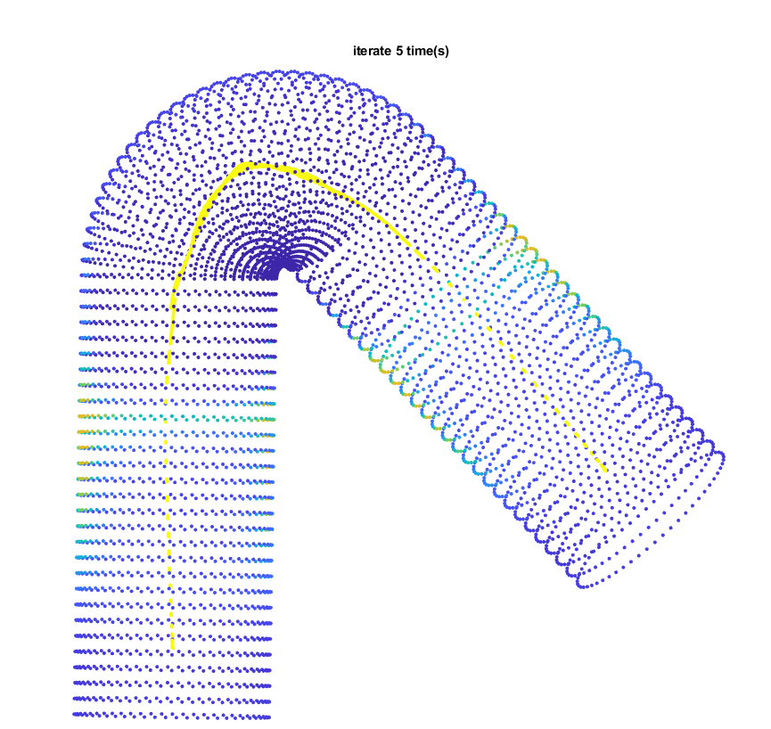
Segmentation approach using reeb graph
Reeb Graph after 5 iteration

Slide 6
Laplacian Contraction
Contraction by volume after every iteration
Notes:
Helps in determining when to stop the contraction.

Slide 7
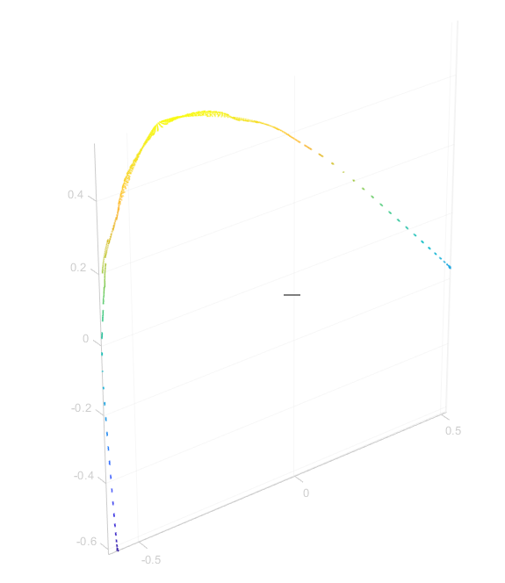
Segmentation approach using reeb graph
Skeleton structure of the bent cylinder

Slide 8
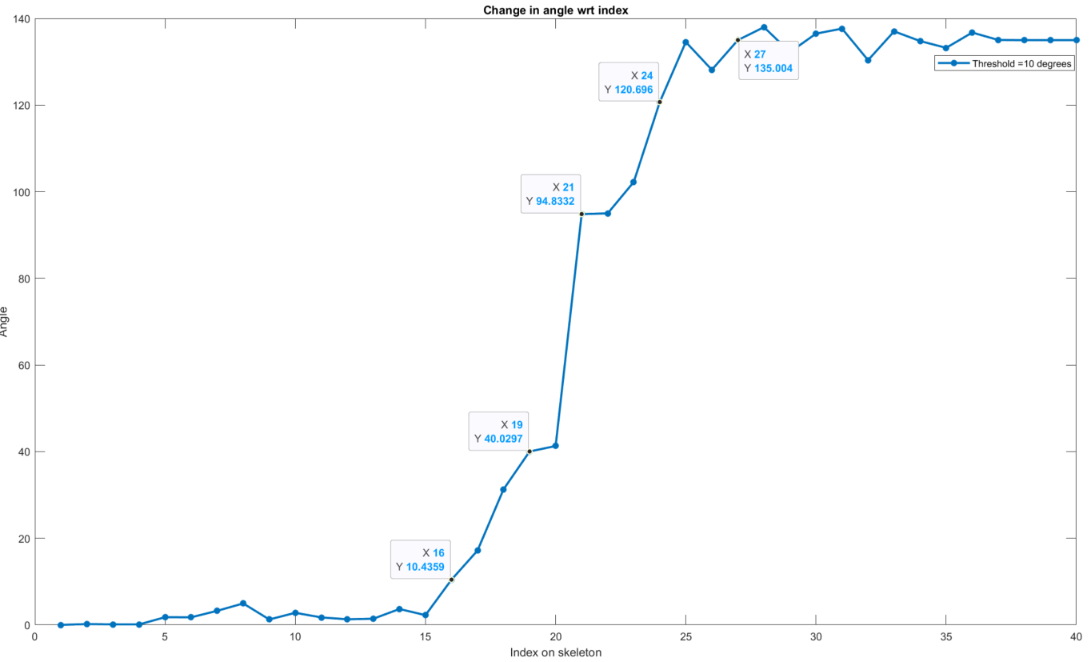
Critical points for segmentation
Derivative of change in angle to compute critical points

Slide 9
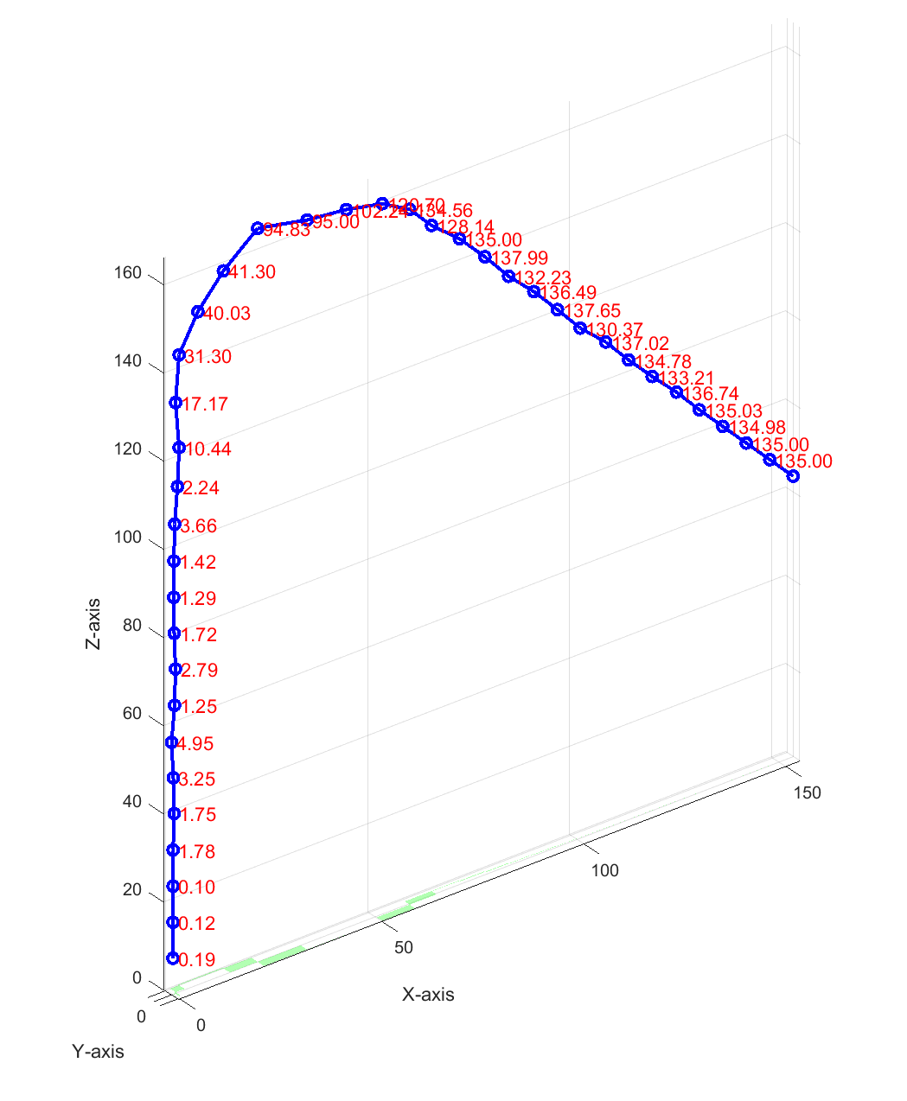
Critical points for segmentation
Using initial threshold as 10 degrees
= Critical points

Slide 10
Critical points for segmentation
Segment 1

Slide 11
Critical points for segmentation
Segment 2

Slide 12
Critical points for segmentation
Segment 3

Slide 13
Critical points for segmentation
Segment 4

Slide 14
Critical points for segmentation
Segment 5

Slide 15
Critical points for segmentation

Slide 16
Advantages
The Laplacian contraction process does not alter the connectivity of the original mesh. The final curve-skeleton is guaranteed to be homotopic to the original object.
The method inherently deals with noise, making it insensitive to noise.

Slide 17
Drawbacks
Drawback of Laplacian Contraction to obtain reeb-graph
The Laplace contraction is an iterative process
Therefore it requires a large computational power
Also it has large time complexity

Slide 18
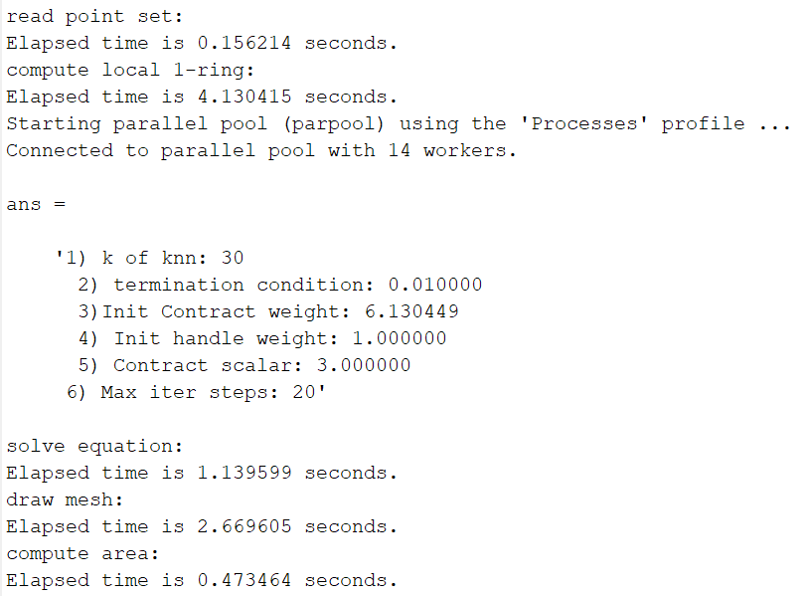
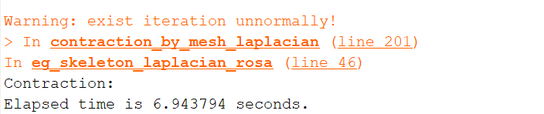
Drawbacks
Drawback of Laplacian Contraction to obtain reeb-graph

Slide 19
Drawbacks
Drawback of reeb-graph
The skeleton extraction only works for closed and branched mesh models.
In case of pyramid the skeleton would just be a straight line which doesn’t retain much about the geometry.
Therefore identifying critical points and performing segmentation is not possible.

Slide 20
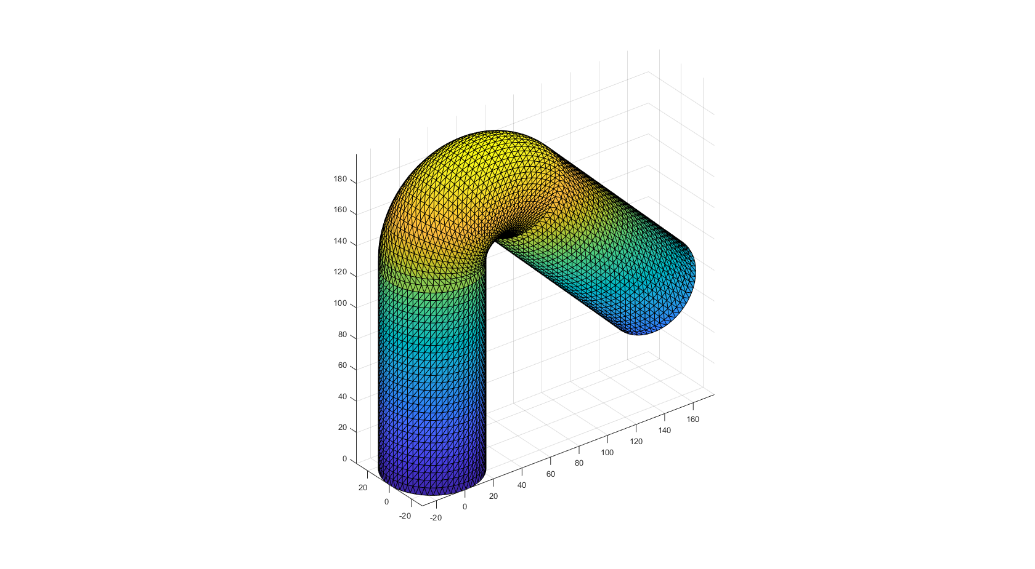
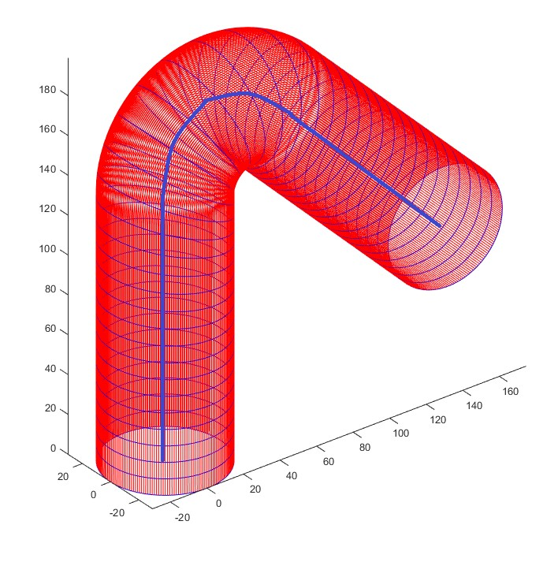
Bent cylinder 3D mesh
Reeb graph extraction from the 3D data

Slide 21
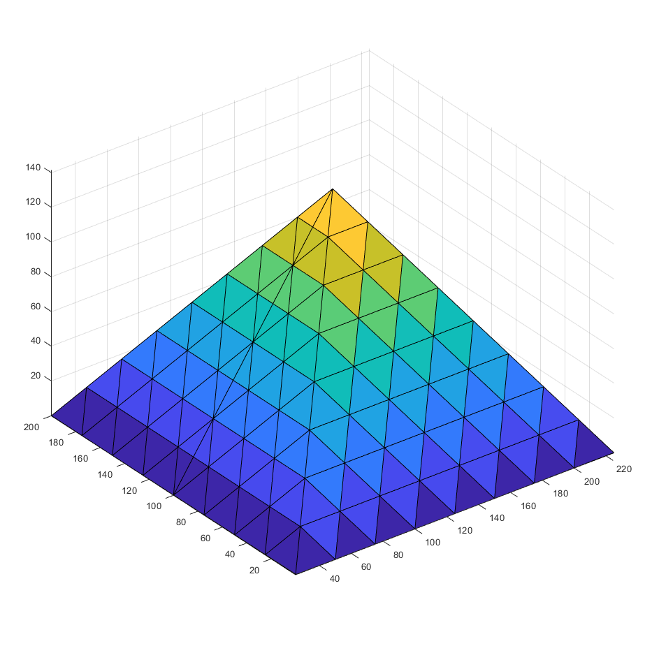
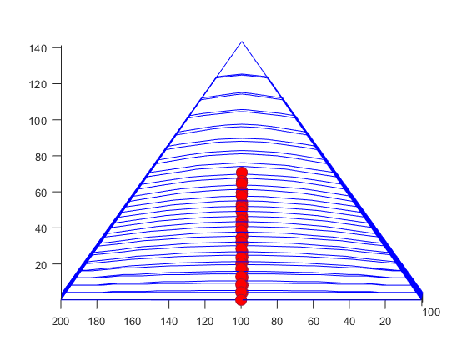
Drawbacks
Drawback of reeb-graph

Slide 22
Time, and distances criterion for segmentation

Slide 23
Time and distances criterion for segmentation
Background theory
This segmentation algorithm focuses on the construction of knitting patterns using a set of rules.
Based on point properties such as time, and distances of points in the 3D object; the rows and short rows are knitted.

Slide 24
Time and distances criterion for segmentation
Overview of the method
Create a full row based on time criterion: if max time value of the previous layer/ row is less than all the time values of the potential current row.
If the time criterion is satisfied, then check for the distance criterion: the distance between all the points in a row and short rows must be less than two times the knitting width.
Short row are created when the time criterion is not met, whereas full rows are obtained if the it is met.

Slide 25
1 | 23 | 43 | 61 | 77 | 92 | 108 | 126 | 146
2 | 24 | 44 | 62 | 78 | 93 | 109 | 127 | 147
3 | 25 | 45 | 63 | 79 | 94 | 110 | 128 | 148
4 | 26 | 46 | 64 | 80 | 95 | 111 | 129 | 149
5 | 27 | 47 | 65 | 81 | 96 | 112 | 130 | 150
6 | 28 | 48 | 66 | 82 | 97 | 113 | 131 | 151
7 | 29 | 49 | 67 | 83 | 98 | 114 | 132 | 152
8 | 29 | 49 | 67 | 83 | 98 | 114 | 132 | 153
9 | 30 | 50 | 68 | 83 | 99 | 115 | 133 | 154
10 | 31 | 51 | 68 | 83 | 99 | 116 | 134 | 155
11 | 32 | 51 | 68 | 83 | 99 | 116 | 135 | 156
12 | 33 | 52 | 69 | 84 | 100 | 117 | 136 | 157
13 | 34 | 53 | 70 | 85 | 101 | 118 | 137 | 158
14 | 34 | 53 | 70 | 85 | 101 | 118 | 137 | 159
15 | 35 | 54 | 71 | 86 | 102 | 119 | 138 | 160
15 | 36 | 54 | 71 | 86 | 102 | 119 | 139 | 160
16 | 37 | 55 | 72 | 87 | 103 | 120 | 140 | 161
17 | 37 | 56 | 72 | 87 | 103 | 121 | 140 | 162
18 | 38 | 57 | 73 | 88 | 104 | 122 | 141 | 163
19 | 39 | 58 | 74 | 89 | 105 | 123 | 142 | 164
20 | 40 | 59 | 75 | 90 | 106 | 124 | 143 | 165
21 | 41 | 59 | 75 | 90 | 106 | 124 | 144 | 166
22 | 42 | 60 | 76 | 91 | 107 | 125 | 145 | 167
Full Rows
Short Rows
Full Rows
Short Rows

Slide 26
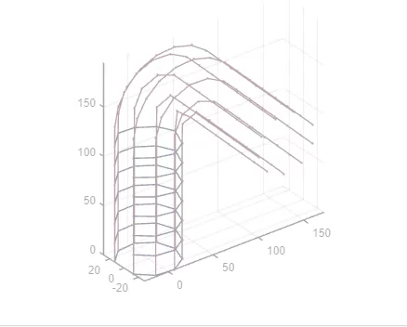
Implementation

Slide 27
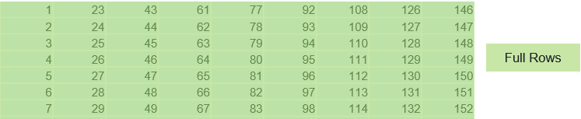
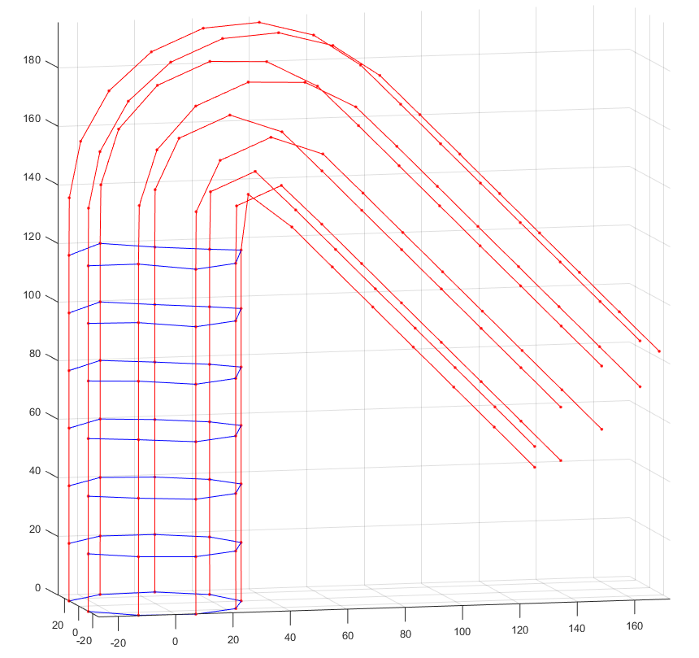

Slide 28
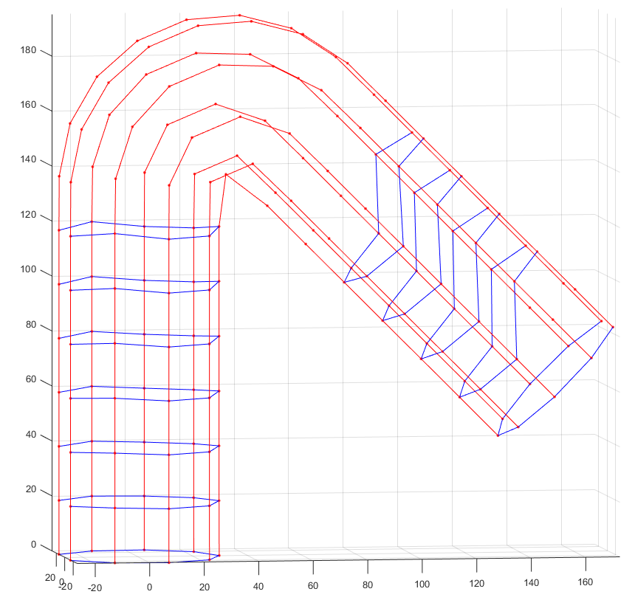
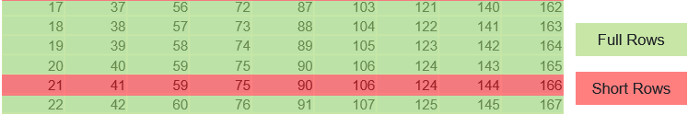

Slide 29
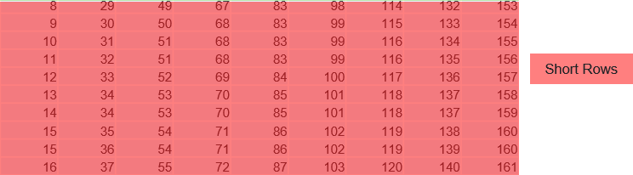
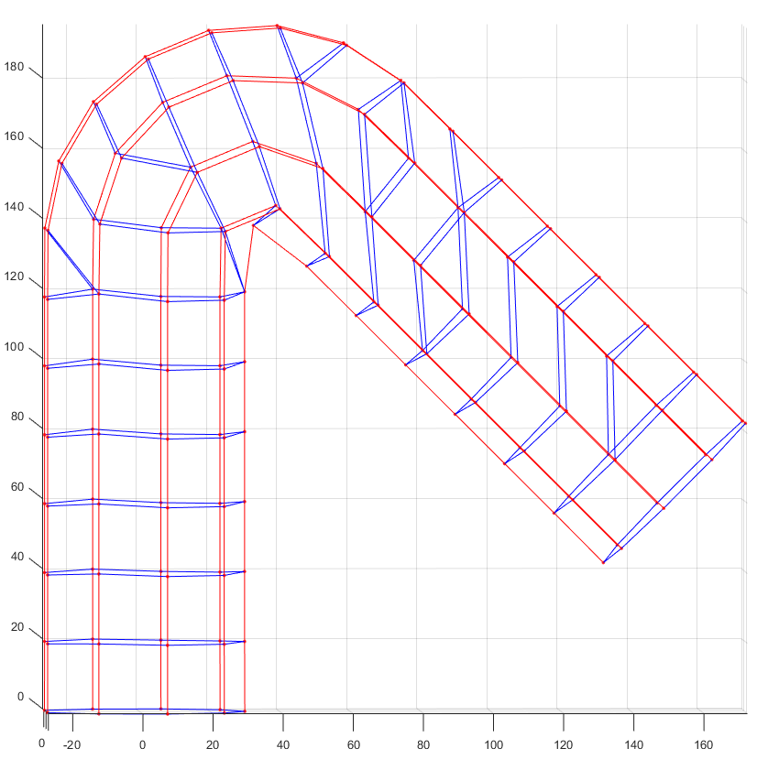

Slide 30
Multipoint connection/ short rows in the second
half of the bent cylinder
Bent cylinder 3D mesh

Slide 31
Advantages
Layer by layer row building therefore more effective segmentation.

Slide 32
Drawbacks
Drawback of Time and distances criterion for segmentation
Due to truncation error in the distance value, one node connects to multiple points with respect to the nearest distance criterion. Causing multiple short rows with the same node.
Generalization is not effectively possible when number of points in a full row keeps changing.
For instance in pyramid, the number of points on the start and the end line are lesser than the number of points on the any other lines in between.
Sequential building of layers results in huge computational time for complex structure.

Slide 33
Time values density and distances criterion for segmentation

Slide 34
Time values density and distances criterion for segmentation
Background theory
This segmentation algorithm focuses on the construction of knitting patterns using point properties such as time values density, and distances of points in the 3D object.
Points (potentially) from same row are on the same time level.
With this knowledge, clustering the time values to find the points forming row.

Slide 35
Time values density and distances criterion for segmentation
Overview of the method
Cluster the time values based on the number of possible rows, which is calculated by the knitting parameter “h” and the largest length in the 3D mesh.
Implement k-means clustering with initial values initialized using equi-spaced time values from -1 to 1 with number of possible rows.
Using these clusters build the full rows and short rows based on the distance criterions.

Slide 36
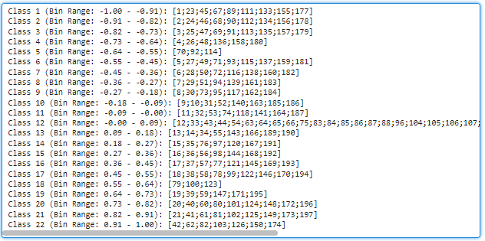
Clustering the time values
Number of classes depends on the height of knitting

Slide 37
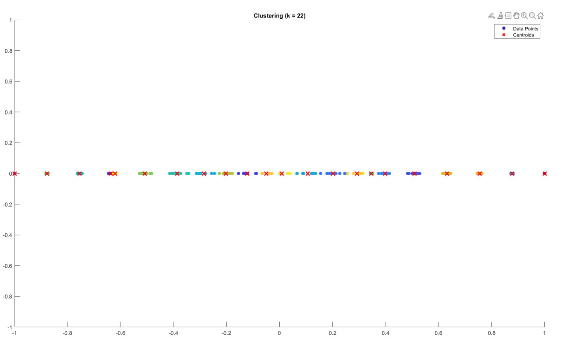
Non-linearity in the structures reflecting in clusters
Definition of bins
straight part
Bent part
straight part
Bent part of the cylinder is highly dense compared to the straight region

Slide 38
Clustering the time values
Formation of full rows and short rows
1 | 23 | 43 | 61 | 77 | 92 | 108 | 126 | 146
2 | 24 | 44 | 62 | 78 | 93 | 109 | 127 | 147
3 | 25 | 45 | 63 | 79 | 94 | 110 | 128 | 148
4 | 26 | 46 | 64 | 80 | 95 | 111 | 129 | 149
5 | 27 | 47 | 65 | 81 | 96 | 112 | 130 | 150
6 | 28 | 48 | 66 | 82 | 97 | 113 | 131 | 151
7 | 29 | 49 | 67 | 83 | 98 | 114 | 132 | 152
8 | 30 | 49 | 67 | 83 | 98 | 114 | 133 | 153
9 | 31 | 50 | 68 | 0 | 99 | 115 | 134 | 154
10 | 32 | 51 | 68 | 0 | 99 | 116 | 135 | 155
11 | 32 | 51 | 68 | 0 | 99 | 116 | 135 | 156
12 | 33 | 52 | 69 | 0 | 100 | 117 | 136 | 157
13 | 33 | 52 | 69 | 0 | 100 | 117 | 136 | 158
14 | 34 | 53 | 69 | 0 | 100 | 118 | 137 | 159
15 | 35 | 54 | 70 | 85 | 101 | 119 | 138 | 160
16 | 36 | 54 | 70 | 85 | 101 | 119 | 139 | 161
17 | 37 | 55 | 71 | 86 | 102 | 120 | 140 | 162
18 | 38 | 56 | 72 | 87 | 103 | 121 | 141 | 163
19 | 39 | 57 | 73 | 88 | 104 | 122 | 142 | 164
20 | 40 | 58 | 74 | 89 | 105 | 123 | 143 | 165
21 | 41 | 59 | 75 | 90 | 106 | 124 | 144 | 166
22 | 42 | 60 | 76 | 91 | 107 | 125 | 145 | 167
Full Rows
Short Rows
Full Rows

Slide 39
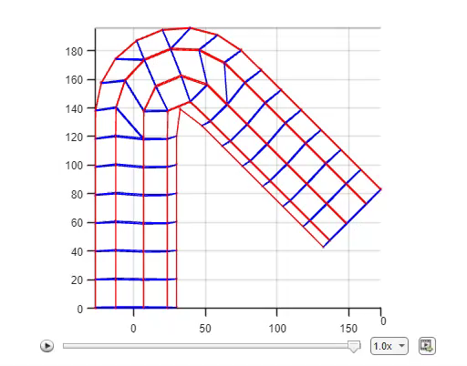
Implementation

Slide 40
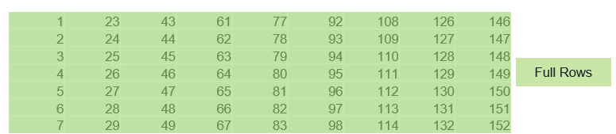
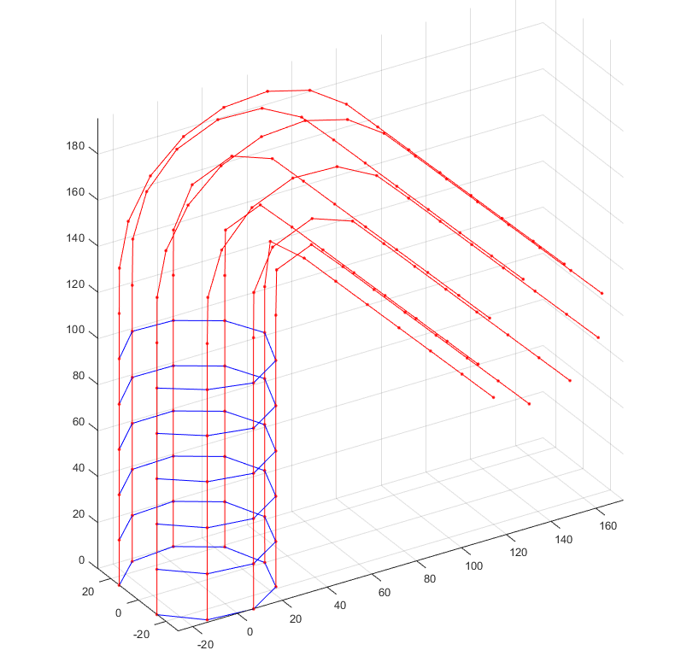
Implementation

Slide 41
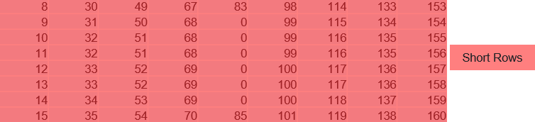
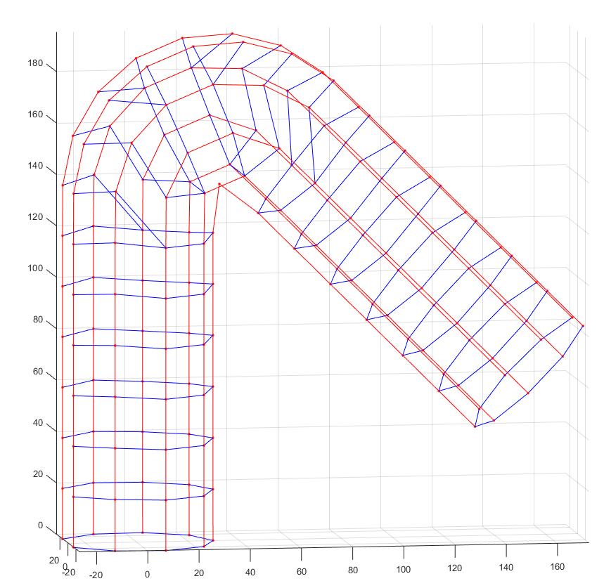
Implementation

Slide 42
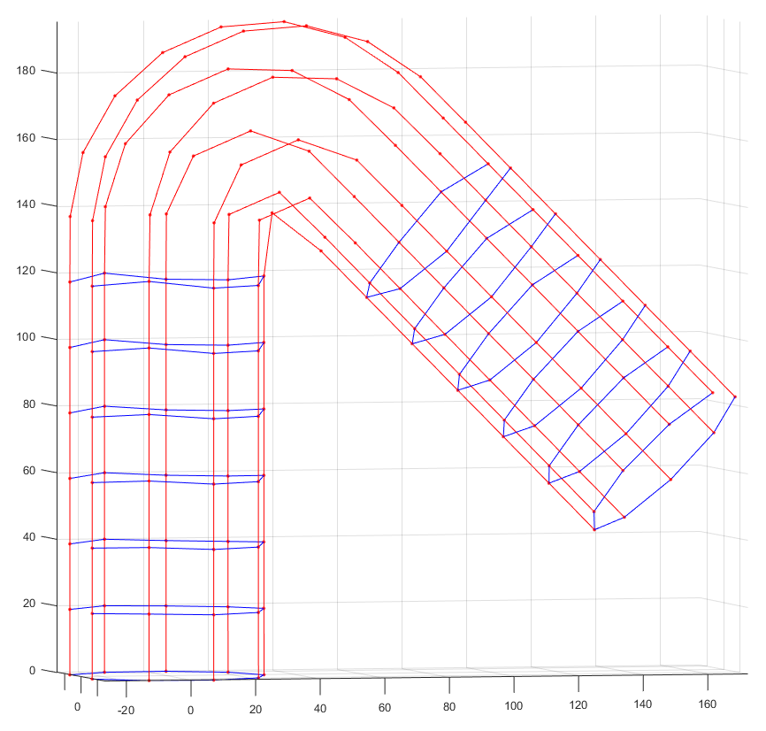
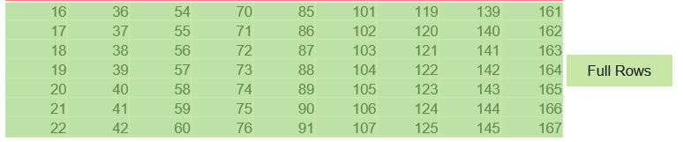
Implementation

Slide 43
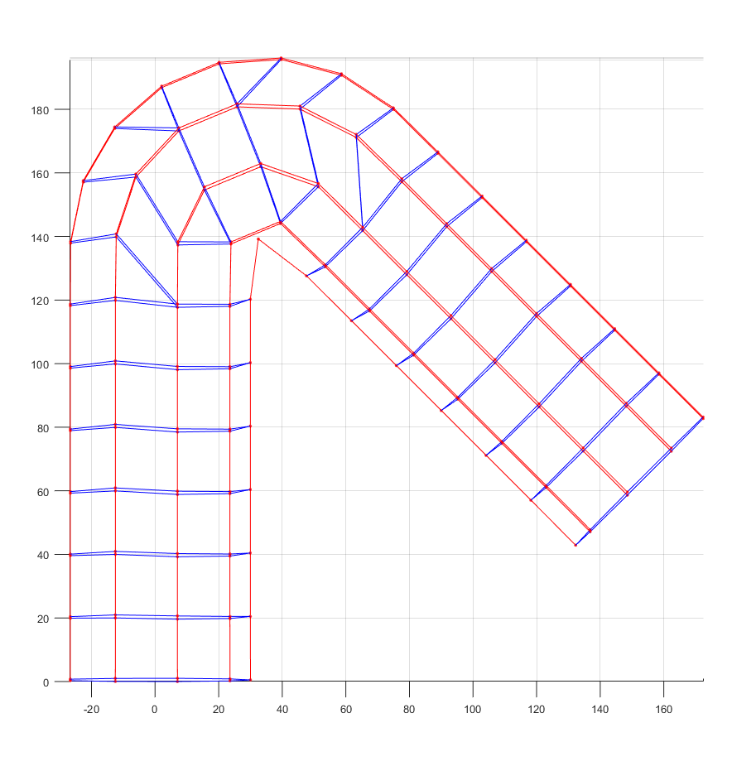
Drawbacks
While creating bins for classes for clustering, due to non linearity of the distribution the marked point is on the boundary of the bins.
Subsequently, it is not considered while creating short row

Slide 44
Drawbacks
This missing point depends on the geometry of the object, point’s density between start line and end line.
Therefore there is need of exhaustive list of geometries for generalization

Slide 45
Clustering the time values
Formation of full rows and short rows
1 | 23 | 43 | 61 | 77 | 92 | 108 | 126 | 146
2 | 24 | 44 | 62 | 78 | 93 | 109 | 127 | 147
3 | 25 | 45 | 63 | 79 | 94 | 110 | 128 | 148
4 | 26 | 46 | 64 | 80 | 95 | 111 | 129 | 149
5 | 27 | 47 | 65 | 81 | 96 | 112 | 130 | 150
6 | 28 | 48 | 66 | 82 | 97 | 113 | 131 | 151
7 | 29 | 49 | 67 | 83 | 98 | 114 | 132 | 152
8 | 30 | 49 | 67 | 83 | 98 | 114 | 133 | 153
9 | 31 | 50 | 68 | 0 | 99 | 115 | 134 | 154
10 | 32 | 51 | 68 | 0 | 99 | 116 | 135 | 155
11 | 32 | 51 | 68 | 0 | 99 | 116 | 135 | 156
12 | 33 | 52 | 69 | 0 | 100 | 117 | 136 | 157
13 | 33 | 52 | 69 | 0 | 100 | 117 | 136 | 158
14 | 34 | 53 | 69 | 0 | 100 | 118 | 137 | 159
15 | 35 | 54 | 70 | 85 | 101 | 119 | 138 | 160
16 | 36 | 54 | 70 | 85 | 101 | 119 | 139 | 161
17 | 37 | 55 | 71 | 86 | 102 | 120 | 140 | 162
18 | 38 | 56 | 72 | 87 | 103 | 121 | 141 | 163
19 | 39 | 57 | 73 | 88 | 104 | 122 | 142 | 164
20 | 40 | 58 | 74 | 89 | 105 | 123 | 143 | 165
21 | 41 | 59 | 75 | 90 | 106 | 124 | 144 | 166
22 | 42 | 60 | 76 | 91 | 107 | 125 | 145 | 167
Full Rows
Un-Clustered point
Short Rows
Full Rows

Slide 46
Advantages
Clustering helps in initializing the time criterion which simplifies the segmentation based on time.

Slide 47
Drawbacks
Drawback of clustering method
Due to non-linearity in the structures the clustering happens between points which are spatially far but timewise near
For instance in the bent part of the bent cylinder there is non- linearity and the points in cluster takes multiple points in one cluster leaving fewer points for the next row, giving rise to undesired short rows.
Iterating over these points is computationally costly.
Initialization of centers of class affect the clustering of time values, generalization of these initialization depends on geometry.

Slide 48
Non-linearity in the structures reflecting in clusters
straight part
Bent part
straight part
Bent part of the cylinder is highly dense compared to the straight region

